Slide 1
Ashok IT Notes
Spring modules and purpose
The Spring framework comprises of many modules such as core, beans, context, expression language, AOP, Aspects, Instrumentation, JDBC, ORM, OXM, JMS, Transaction, Web, Servlet, Struts etc
Spring Core Module:
It provides fundamental concepts of spring framework
a)IOC Container: is a process in which an object defines its dependencies without creating them.
b) Dependency Injection
c)Autowiring
Using core module we can develope classes with lose Coupling .
Spring Context Module:
➔It provides configuration support for spring application development .
(xml or annotations or java based)

Slide 2
Spring Jdbc Module:
➔ it is used to simplify the Database connectivity using java
Jdbc logic
//load driver
// get conn
//create stmt
// execute query
// close conn
Spring jdbc
//execute query
jdbc template .execute Query
Note : spring jdbc internally using JDBC api only.
Spring ORM
➔ it is used to simplify the persistence layer development with ORM
principles.
➔ we can represent data in the form of objects
Spring ORM provided the methods to perform curd operations using objects
Note : Spring ORM internally using Hibernate and hibernate internally uses JDBC Api.
Spring WEB Module:
➔ it is used to developer web applications (C 2 B)
We can avoid boiler plate code in web app development capturing form data and converting form data into objects
using web mvc module.

Slide 3
Spring Rest Module:
➔Used to develop distributed application (B 2 B)
Spring Module : Microservices re developed
Spring Security :
-Https basic
- Oauth 2.0
-JWT
Spring Batch Module : to perform Bulk Operations (banking operations)
➔spring boot is the extension of spring framework which supports Rapid
development of application and Auto configuration
Project Development :Collections of classes
POJO class (DTO/VO /Binding): to represent Data
1) POJO classes (DTO / VO / Binding / Command): To represent data
2) Component Classes (controller/service/Dao/util): logic
Controller --> logic to handle request & resp

Slide 4
Service --> business logic (validation, otp, reports)
DAO --> logic to communicate with DB
Utils --> email otps, pwd otps, date otps
===========================================================================================
How one java class method can access/communicate another java cl method ?
===================================================================================================
Inheritance (IS-A)
Composition (HAS-A)
Note: With IS-A and HAS-A our classes will become tightly coupled.
=> To overcome this tightly coupling we need to develop our classes with strategy design pattern (GOF).
Dependency Injection
The process of injecting dependent object into target object is called dependency injection
➔ we can perform 3 ways
Filed Injection : injecting dependent obj into target class variable directly
Setter injection : Injecting dependent obj into target class using target class setter method
Constructor injection: Injecting dependent obj into target class using target class constructor
Note : in normal java apps programmer are responsible to perform DI
If we are using spring core the IOC will take care of Dependency injection.

Slide 5
What is IOC ?
➔ IOC is an principle which responsible to manage(object creation ) and collaborate dependencies among the obj in the
application.
Bean Definition: In Spring, the objects that form the backbone of your application and that are managed by the Spring IoC container are called beans.
A bean is an object that is instantiated, assembled, and otherwise managed by a Spring IoC container
IOC container are two types
Bean Factory :
ApplicationContext; which is used to start ioc Container
<property> represents setter injection
<constructor –args> represents the construction injection
Beans Scope
Scope will decide when to create an object for spring bean and how many objects should be created for spring bean.
Singleton (default)
prototype
Request
Session
➔Singleton(eager Loading) bean means only one object will be created (at time of ioc start)

Slide 6
Prototype : when the scope is prototype every time new object will be created
when we call get Bean( ) method.
Note: IOC will perform eager loading for singleton bean and it will perform lazy loading for prototype
Bean LifeCycle: will be managed by IOC Container
Autowiring : if we perform DI using property and constructor-arg tags then it will be called manual wiring.
We will use ref attribute to specify dependent bean
<property name =“ui” ref=“cedit”/>
Autowiring (Ioc will identify the dependent bean obj )
To use Autowiring configurations changes are required
Autowiring modes
1) byName (identify dependent obj of bean by name)
2)byType(identify dependent obj of bean by type)
3)Constructor
4) NONE (Default)

Slide 7
SpringBoot
What is SpringBoot ?
Spring is a approach to develop spring framework based applications with less configuration;
➔Spring boot is an extension for spring .
➔SpringBoot supports rapid application development.
SpringBoot = (spring + autoConfig)- xml.config
What type of applications we can build ?
➔ By using SpringBoot we can develop several types of applications
1)Stand alone appli
2)web application (C2B)
3)distributed application(B2B)
webservices /rest apis
What are the advantages of SpringBoot?
Pom starters :To simplify project maven and gradle configurations serval starters like
SpringBoot –starter-web
SpringBoot-starter-data-Jpa
Springboot –starter-mail
SpringBoot-starter-security

Slide 8
Dependency version conflicts
Embedded servers
Autoconfiguration
Actuators
➔SpringBoot will provide server to run ours application
a) tomcat(default)
b)jetty
c)netty
AutoConfiguration ➔it is one of the most important feature in SpringBoot
➔Boot will identify required configurations for the applications based on pom starters and It will
provide that configurations at runtime
Actuators
Actuators are used to monitor and manage our application

Slide 9
Spring Boot Application Folder Structure
src/main/java => To write application source code
Application.java (Start class & Entry Point) I
src/main/resources =>To keep application config file
application.properties
src/test/java ==> To write JUnit test cases
ApplicationTest.java
src/test/resources ==> To keep unit test config files
Maven Dependencies => libraries downloaded
target ==> byte code (.class files)
pom.xml => Maven config file
What is start class in spring boot?
➔Start class is the entry point to boot application execution
Also called main class in SpringBoot
When we create boot application by default start class is created.
@SpringBootApplication = @SpringBootConfigutation(java class is represented as configuration class) +@ Enable Autoconfiguration +@ComponentScan (use to scan the project and identify spring bean class and also scan basePackage).

Slide 10
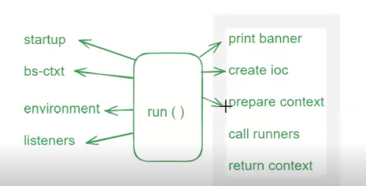
How to represent java class as spring bean ?
@Compoent : To represent java class as spring bean class level annotation IOC will create object for the class UseCase :when you want to create generic bean without specifying its role in application.
@Service : To represent java class as spring bean The classes which have business logic and provide service
@Repository: class level annotation The classes which communicate with data base represent java class as spring bean
@Configuration :: It is a class level annotation which will contain customised beans
@Bean : it is a method level annotation to write own methods where IOC can’t create object programmer will create object and ioc will call the method
@Controller : It is class level annotation to handle http request in web application (C2B) return UI pages as response
@RestController : to handle http request in rest apis (B2B) return direct response
Run method in SpringBoot

Slide 11
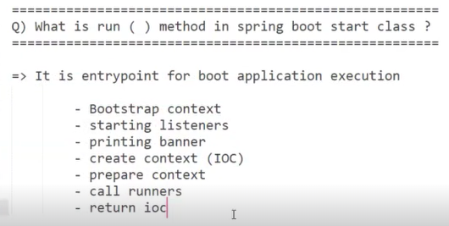
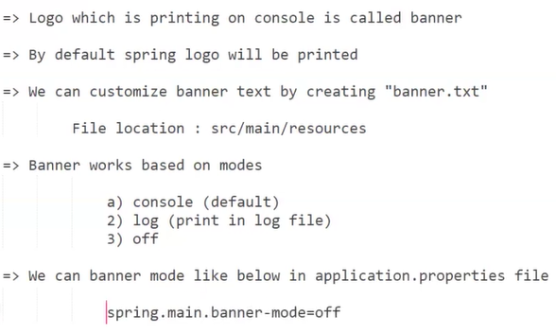

Slide 12
How ioc will be started in SpringBoot?
run() method is responsible to start ioc in bootapp
Run () method will use predefine class to start ioc based on pom starter.
Default app (Stand alone): spring-boot-starter
class - Annotation ConfigApplicationContext
Web app : spring-boot-starter-web (tomcat)
class - AnnotationConfigServletWebServerApplicationContext
Reactive app :spring-boot-stater-webflux (netty)
class –AnnotationConfigReactiveWebServerApplicationContext
What is Runner in SpringBoot?
Runner is used to execute the logic only once when application started.
public class MyAppRunner implements ApplicationRunner {
@Override
public void run(ApplicationArguments args) throws Exception {
// TODO Auto-generated method stub
System.out.println("Applicationrunner called .....");
}
}

Slide 13
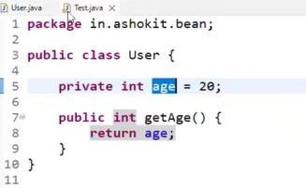
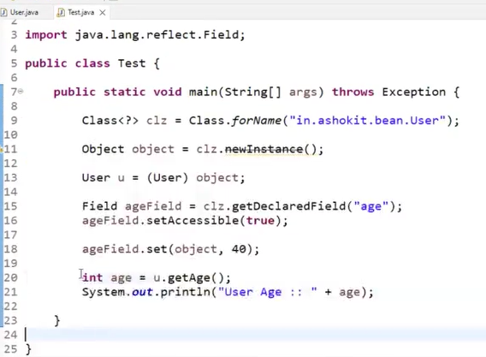
Autowiring :It is use to perform dependency Injection
➔Injecting one object bean into another bean object is called Autowiring .
We can perform dependency injection in 3 ways
1) setter Injection
2)constructor injection
3) field Injection
Note : IOC container is responsible for dependency injection
How access private class modifier in framework

Slide 14
What is field injection
Injecting dependent bean object into target class bean object using target bean variable called Field Injection
Note : Internally IOC will perform reflection api to perform filed injection.
Note : Using reflection api we can access the private variables out side the class.
Autowiring modes
1)byName :based on the variable name identify the variable dependent bean
2)byType : based on the variable datatype identify the dependent bean
What is @Qualifier annotation ?
Used to identify the bean based on name
Class Robot {
@Autowired
@Qualifier("chip32")//identify the bean based on name
private IChip chip;
}
Note : Ichip is an interface having chip32bit & chip64bit
Implementation classes
➔ based on above configuration bean is injection who has “chip64bit ”

Slide 15
What is ambiguity problem in Autowiring ?
If one interface having more than one Impl class then we will get ambiguity problem in “byType” mode
To resolve byType ambiguity problem we can use @Primary annotation
The bean which have @Primary annotation will get highest priority of Autowiring .
What is Bean scope ?
=> Bean scope represents how many objects should be created for spring bean.
=>By default every spring bean is singleton (only one object)
=> We can customize bean scope using @Scope annotation
=> prototype scope represents every time new object.
Note: For singleton beans objects will be created when ioc container starting.
=========================================================================================================
CI ------> target class constructor
=>dependent bean is mandatory to create target bean
=> if dependent bean is not available then target bean can’t be created.
=> first dependent bean object will be created and the target class bean object will create .
SI ----> target class Setter method
=>first target bean object will be created the only dependent bean object will create.
=>After target bean creation using target bean obj setter method is called(optional)

Slide 16
FI ---- target class variables
=> ioc will use reflection api to perform FI
= FI is simple to write.
=> IOC violating oops concepts/principles
=>it is giving chance to violating single responsibility principle.
Embedded Database in spring boot
=> Embedded databases are called temporary databases
=> H2 we can use as embedded database
=> When application starts h2 db will start and when application stopped h2 db also gets stopped.
Note: If application re-started then we will loose old data.
H2 db is used only for practice purpose.
How to use H2 DB in spring boot?
Step-1: Add h2 dependency in pom.xml file
Step-2 Configure H2 datasource properties in
application.properties file
Step-3: Run the application and access h2-console in browser
URL: http://localhost: port/h2-console.
### Step-3 : Run the application and access h2-console in browser
URL: http://localhost: port/h2-console

Slide 17
How to change default container to jetty?
=> When we add web starter then tomcat will become default
embedded container to run boot application.
=> If we want to change from tomcat to jetty then we need to make below changes in pom.xml
### Step-1: Exclude tomact from web-starter dependency
Email Sending using spring boot
=> mail-starter dependency
=> JavaMailSender -> send (Message msg)
- SimpleMessage (plain text)
- MimeMessage (formatted text & attachments)
Note: To send emails we need to configure SMTP details
SMTP: Simple main transfer protocol
We need to generate app password for our gmail account
Email Sending using spring boot
=> To send emails using spring boot we have add 'mail-starter' dependency in pom.xml
=> We need to configure SMTP properties in
application.properties file
Note: In SMTP props, we need to our gmail account credentials for authentication purpose.
Note: We need to generate app password for gmail for authentication.
URL To generate app pwd

Slide 18
Exception Handling in Boot web application
Exception: Unexpected and unwanted situation
=> When exception occurs program will be terminated abnormally
=> We need to handle exceptions for graceful termination.
=> We have below keywords to handle exceptions in java
1) try
2) catch
3) throw
4) throws
5) finally
=> In spring boot we can handle exceptions in 2 ways
1) Controller Based
2) Global Exception Handling
=> In spring boot we can handle exceptions in 2 ways
1) Controller Based (specific to class)
2) Global Exception Handling (entire application)
@ControllerAdvice
public class AppExceptionHandler {
@ExceptionHandler (value = Exception.class) public String handleAe (Exception e) {
return "exView";
}

Slide 19
1) Query Parameters (key-value)
=> Query Params are used to send data to server in URL
=> Query Params will represent data in key-value format
=> Query params will start with ?
=> Query Params will be separated by &
=> Query Params will present at end of the URL
Note: We can read query parameters from URL using @RequestParam annotation in the controller.
Path Parameters
=> Query Params are used to send data to server in URL
=> Path Parameters will represent value directly
ex: www.youtube.com/c/AshokIT
=> Path Parameters will be separated by '/'
=> Path Parameters can present anywhere in the URL
Ex :www.ashokit.in/course/{java}/info
=> We can read Path Parameters using @PathVariable annotation.

Slide 20
What is @ResponseBody?
=> It is used to send direct response to client without any view page.
=> This can be used at controller class level and method level
Note: If we use at class level then it is applicable for all methods in that class
@Controller + @ResponseBody = @RestController
Form Validations ?
=> To restrict users to provide valid information in the form
- Client Side Validations
- Server side validation
=> Client side validations will execute at browser. People can disable client side validations using inspect option in browser.
=> Server side validations will execute in our code. These are highly recommended in application.
=> To implement server side validations we will use below starter in pom.xml file
<dependency>
<groupId>org.springframework.boot</groupId>
<artifactId>spring-boot-starter-validation</artifactId>
</dependency>
=> We can use below annotations to perform server side validations Activate Windows

Slide 21
=> We can use below annotations to perform server side validations
@Valid
@NotEmpty
@NotNull
@Size @Email
Note: We will use these annotations
JSP
=> JSP is used to develop presentation layer
Note: JSP will be translated to Servlet for execution..
=> Spring Web MVC supports JSP as presentation technology.
## Step-1: Add tomcat-embed-jasper dependency in pom.xml file
<dependency>
<groupId>org.apache.tomcat.embed</groupId> <artifactId>tomcat-embed-jasper</artifactId>
</dependency>
## Step-2: Create jsp pages in below location
Location: src/main/web/views/index.jsp
## Step-3: Configure view resolver in application.properties file
spring.mvc.view.prefix=/views/ spring.mvc.view.suffix=.jsp

Slide 22
Actuator
Actuator is additional features to help you monitor and manage your application when you push it to production.
You can choose to manage and monitor your application by using HTTP endpoints or with JMX.
Auditing, health, and metrics gathering can also be automatically applied to your application.
=> Production ready features...
=>With the help of actuators we can get below details
- Health of App
Beans loaded Metrics
loggers
URL Mappings
- Config Props
Thread Dump
Heap Dump
Note: By default /health will be exposed.
=>We need to write below property to expose other endpoints
management.endpoints.web.exposure.include=*
=> We can exclude actuator endpoint like below
management.endpoints.web.exposure.exclude=beans

Slide 23
What is shutdown endpoint ?
=> It is used to stop the application.
Note: We need to enable shutdown endpiont in our properties file
management.endpoint. shutdown.enabled=true
Note: Shutdown endpoint is mapped to POST request. We can send post request using POSTMAN.
What are Profiles in Spring Boot ?
Note: Environment means a platform which is used to run our application.
=> In Realtime one application contains multiple environments like below
- Local Dev
-QA , - UAT
PILOT
- PROD
-> Local env is used for development purpose
-> DEV env is used by developers for integration testing
-> QA env is used by Testing team for system integration testing
-> UAT env is used by Client side team for testing(GO/NO-GO)
-> PILOT env is used to test app with live data (Pre-Prod)
-> PROD env is used for live access.

Slide 24
=> Below properties will be changing from environment to environment.
--datasource properties
-kafka properties
- redis properties
- payment-gateway properties
Note: to deploy code everytime we have to change config props/
=> To avoid this problem we will use Profiles in springboot
=> Using profiles we can maintain environment specific configuration.application.properties
application-dev.properties---- main file
application-qa.properties
application-uat.properties
application-prod.properties

Slide 25
JSON
=> JSON stands for Java Script Object Notation
=> JSON represents data in key-value format
Ex:{
"id": 101,
"name" : : "Ashok",
"phno": 12345,
"gender" "Male“ }
=> JSON is very light weight
=> JSON is platform independent & language independent
=> JSON is used to transfer data over a network
Distributed applications will use JSON data for request & response
Working with JSON in Java Applications
=> Java Applications can use JSON data
=> To work with JSON in Java app, we have third party libraries
a) Jackson
b) Gson

Slide 26
RestFull Api’s
=> By using above libraries we can convert JSON data to Java Object and vice versa
jackson/gson
java obj <----------------------------> json data
=> The process of converting java obj to json is called as Serialization.
=> The process of converting json data to java obj is called as de-serialization.
Webservices
-> It is a distributed technology which is used to develop distributed application.
-> If one application is communicating with another application then those apps are called as distributed applications.
-> Distributed applications should have intereoperability
-> Intereoperability means language independent & platform independent.
java app <---------> python app
java app <---------> dot net app
java-app <-------->.php app
java app <-------->Angular app
java app<---------> React app
Note: Distributed applications are used for code reusability
(Business to business communication)

Slide 27
=> Distributed applications can be developed in 2 ways
1) SOAP Webservices (Outdated)
2) RESTful Services (trending)
What is REST API ?
Distributed App
=> rest api / restful service / restful webservice/ microservice
=> REST API means an application which provides business logic to other applications through internet.
REST API Architecture
1) Provider / Resource
2) Consumer / Client
=> Provider means the application which is providing business services to other applications.
=> Consumer means the application which is accessing business services from other application.
Ex: MakeMyTrip & IRCTC
Note: We will use JSON to exchange data between provider & consumer.
=> HTTP stands for Hyper Text Transfer Protocol
=> HTTP acts as mediator between Client & Server
=> HTTP is stateless protocols
=>We need to know about
1) Http Request
2) Http Response
3) Http Methods
4) Http Status Codes

Slide 28
HTTP Request Structure
=> It contains below parts
a) Request Line (Http Method + URL)
b) Request Headers (Metadata) (K-V)
c) Request Body (Payload text/xml/json)
HTTP Response Structure
=> It contains below parts
a) Response Line (Status Code + Status MSG)
b) Response headers (Metadata - K & V)
c) Response body (Payload text/xml/json)
HTTP Methods
GET -----> It is used to get the data (no request body)
POST------->Send data to provider/server(create record)
PUT---> Update data (complete update)
PATCH <------->Partial Update
DELETE ---> Delete Record

Slide 29
HTTP Status Codes
1xx (100-199): Informational
2xx (200-299) : Success
3xx (300-399) Redirectional
4xx (400-499): Client Error
5xx (500-599): Server Error
404 - Resource Not Found
500 - Internal Server Error
200 –OK
Developing REST APIS using Spring Boot
=> We will use 'spring-boot-starter-web' dependency
=> As part of REST API development we need to learn
1) Provider Development
2) Consumer Development
=> We will use below annotations as part of Provider development

Slide 30
=> We will use below annotations as part of Provider develope
@RestController (@Controller + @ResponseBody)
@GetMapping @PostMapping @PutMapping @PatchMapping
@DeleteMapping
@RequestParam
@PathVariable
@RequestBody
=> We have below 3 options to develop Consumer
1) RestTemplate
2) WebClient
3) FeignClient
Note: We will use POSTMAN to test provider functionality.
Note: We will use Swagger to generate provider documentation.
HTTP GET Request
=> GET request is used to get data from Server/Provider.
=>GET request will not contain request body.
=> If we want to send data in GET request then we need to use
1) Query Parameters
2) Path Parameters
Ex-1 http://localhost:8081/welcome?name=raju
Ex-2: http://localhost:8081/greet/john

Slide 31
=> Query Parameters we can read using @RequestParam annotation
Path Parameters we can read using @PathVariable annotation.
@RequestParam To read query params from url
@PathVariable: To read path params from URL
@RequestBody: To read data from http req body (payload)
What is Swagger?
Swagger is used to generate documentation for REST API
Using Swagger we can test rest api.
Add below dependency in pom.xml file
<dependency>
<groupId>org.springdoc</groupId>
<artifactId>springdoc-openapi-starter-webmvc-ui</artifactId>
<version>2.5.0</version>
</dependency>
=> After running the application use below url to access swaager-documentation
URL: http://localhost:8081/swagger-ui/index.html/

Slide 32
-> XML stands for extensible markup language
-> xml is free and open source
-> xml governed by w3c org
-> xml represents data in the form elements
-> XML is intereoperable (language independent)
syntax:
<person>
<id>101</id>
<name>Ashok</name>
</person>
-> We have 2 elements types of xml
1) simple element (contains data directly)
2) compound element (contains child elements)
Dealing with xml in java applications
=> Upto java 8 we have JAX-B api in jdk to deal with xml files in java.
=> Using JAX-B api we can convert java object to xml and vice versa.
jax-b
java obj <---------------> xml data
Note: From java 9 onwards jax-b api is not part of JDK software.

Slide 33
=> To deal with xml data in spring boot rest api we need to add below dependency in pom.xml file
<dependency>
<groupId>com.fasterxml.jackson.dataformat</groupId>
<artifactId>jackson-dataformat-xml</artifactId>
</dependency>
=> Below is the rest controller method which supports both xml and json response
Consumer
=>The application which is accessing other applications is called as Consumer application.
=> Using Spring Boot we can develop Consumer in 3 ways
1) RestTemplate
2) WebClient
3) FeignClient
=> RestTemplate supports only Synchronous communication
=> WebClient supports both sync & async communication
=> Feign Client is used for inter service communication in Microservices

Slide 34
What is Synchronous Communication ?
=> After sending request to provider if consumer is waiting for the response
then it is called as Synchronous communication.
REST API Calls: One microservice makes a direct HTTP request to another microservice's REST API and waits for the response.
gRPC Calls: One microservice uses gRPC to make a call to another microservice and waits for the response.
Remote Procedure Calls (RPC): A service invokes a method on a remote service and waits for the method execution to complete and return a result.
What is Asynchronous Communication ?
After sending request to provider if consumer is not waiting for the response
this type of communication allows the sender to send a message without waiting for the receiver to be ready or available to process it. The receiver can then process the message at a later time, independent of the sender's timing.
then it is called as asynchronous communication.
Key Characteristics
Decoupling: The sender and receiver are decoupled in time, meaning they do not need to interact with each other simultaneously.
Buffering: Messages are often stored in a queue or buffer until the receiver is ready to process them.
Non-blocking: The sender can continue its operations without being blocked, waiting for the receiver's response.

Slide 35
What is exceptional Handling in spring boot ?
2) Global Exception Handling
@ControllerAdvice. - Class level This annotation is used to define global exception handlers that can handle exceptions across multiple controllers. It centralizes exception handling logic, making your code cleaner and more maintainable.
@ExceptionHandler - Method level
This annotation allows you to define methods within your controller classes to handle specific exceptions.
When an exception of the specified type is thrown, the corresponding @ExceptionHandler method is invoked to handle it.
@RestControllerAdvice - Class Level

